Slide 1
Describe direct data entry and associated devices, e.g. magnetic stripe readers, chip and PIN readers, Radio Frequency Identification (RFID) readers, Magnetic Ink Character Reader (MICR), Optical Mark Reader (OMR), Optical Character Reader (OCR), bar code reader Identify the advantages and disadvantages of any of the above devices in comparison with others

Slide 2
 |  |  |  |  |  |  |  |  |  |  |  |  | 3 |  |  | 4
 | 1 |  |  |  |  |  | 2
1
 |  |  |  |  |  |  |  |  |  |  |  |  |  | 3
 |  |  |  |  |  |  |  |  | 2
 |  |  |  |  |  |  |  |  |  |  |  |  | 4
Down
Read multiple choice/lottery ticket marks
Read Bank Cheques
Secure method of payment
Scan an item at the POS
Across
Can be used to gain entry
Uses radio frequency signals
Paying for items in a shop
Scans converts text into an editable format.

Slide 3
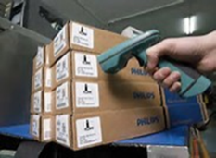
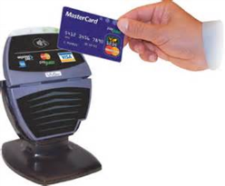
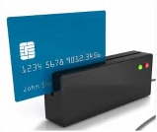
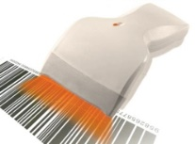
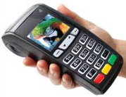
Matching Input Device and their Use
Example Use: To make a small payment without entering a pin.
Bar Code Scanner
Example Use: To make a secure payment
Chip and Pin
Radio Frequency Identification
Manage Stock Control
Contactless Card Reader
To Scan Items at the POS
Example Use: To gain entry into a room
Magnetic Strip Reader

Slide 4
Fill in the blanks
Chip and Pin Readers are used _____ terminals to make a _______ payment using a debit or credit card compared to ___________ methods.
Magnetic Strip Readers are used to read _____ found on magnetic stripes found on the back of _____.
RFID reads information stored on ______ using radio waves. RFID tags can be attached to _________ or animals/people. Can read objects from a _________ and in _______.
MICR is able to read _____________ printed in a special ink in order to process bank ___________.
OMR is able to read ________ written in pen or ________. Used to scan in marks from multiple _________ exams, surveys, and lottery _________.
OCR scans text from hardcopies and ___________ it into an _________ form. Used in Used in Self-Immigration System at __________.
objects
choice
bulk
Cards
Secure
POS
data
Characters
distance
cheques
Marks
editable
pencil
airports
tags
tickets
converts
contactless

Slide 5
Questions
1) Why is Chip and Pin a secure method of payment at a POS compared to using contactless cards?
2) Describe input and output devices used at a POS (Point of Sale) terminal.
3) Compare the use of OCR, OMR, MICR and Keyboard when entering data into a system?

